Slide 1
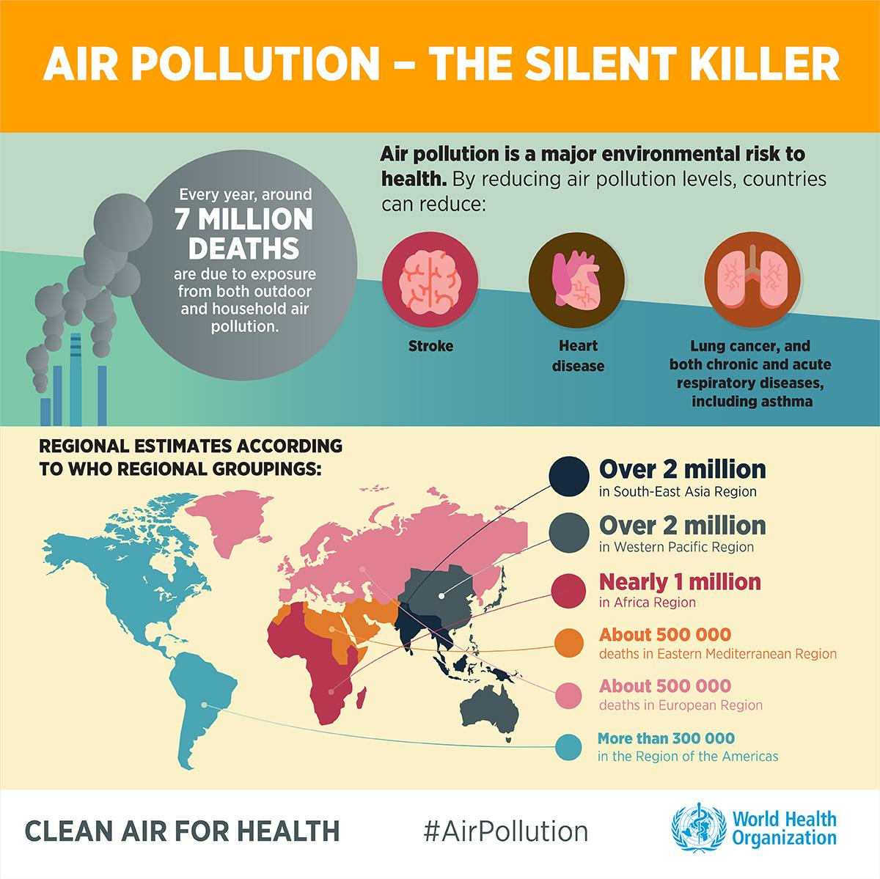
Notes:
Hi everyone, our project presented today is about one of the most talked topic which is Air Pollution. Do these number shocked you? 7 millions deaths every year caused by air pollution. Many fatal diseases caused by air pollution that human has to face.
How many of you have the habit to check the air quality of the location where you live before going out?
Well, we find that checking air quality often is quite important because it gives you the information about how clean the air that you breath. So, we thought that it could be interesting to have some knowledge and insights of this topic. That s why, we selected Air quality as the topic for our project.

Slide 2
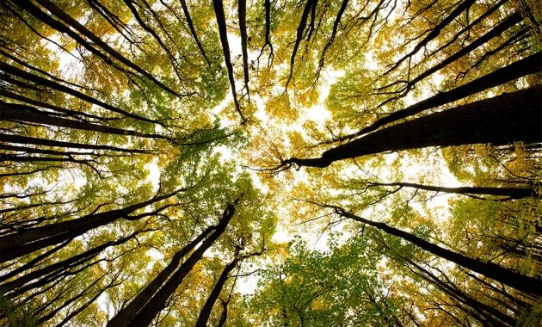
AIR QUALITY
Tatiana Martinez
Thai Linh Bui

Slide 3
Table of contents
Introduction
Description of the dataset
Data cleaning and manipulation
Exploratory Data analysis with visualization
Hypothesis testing
Difficulties & Improvements

Slide 4
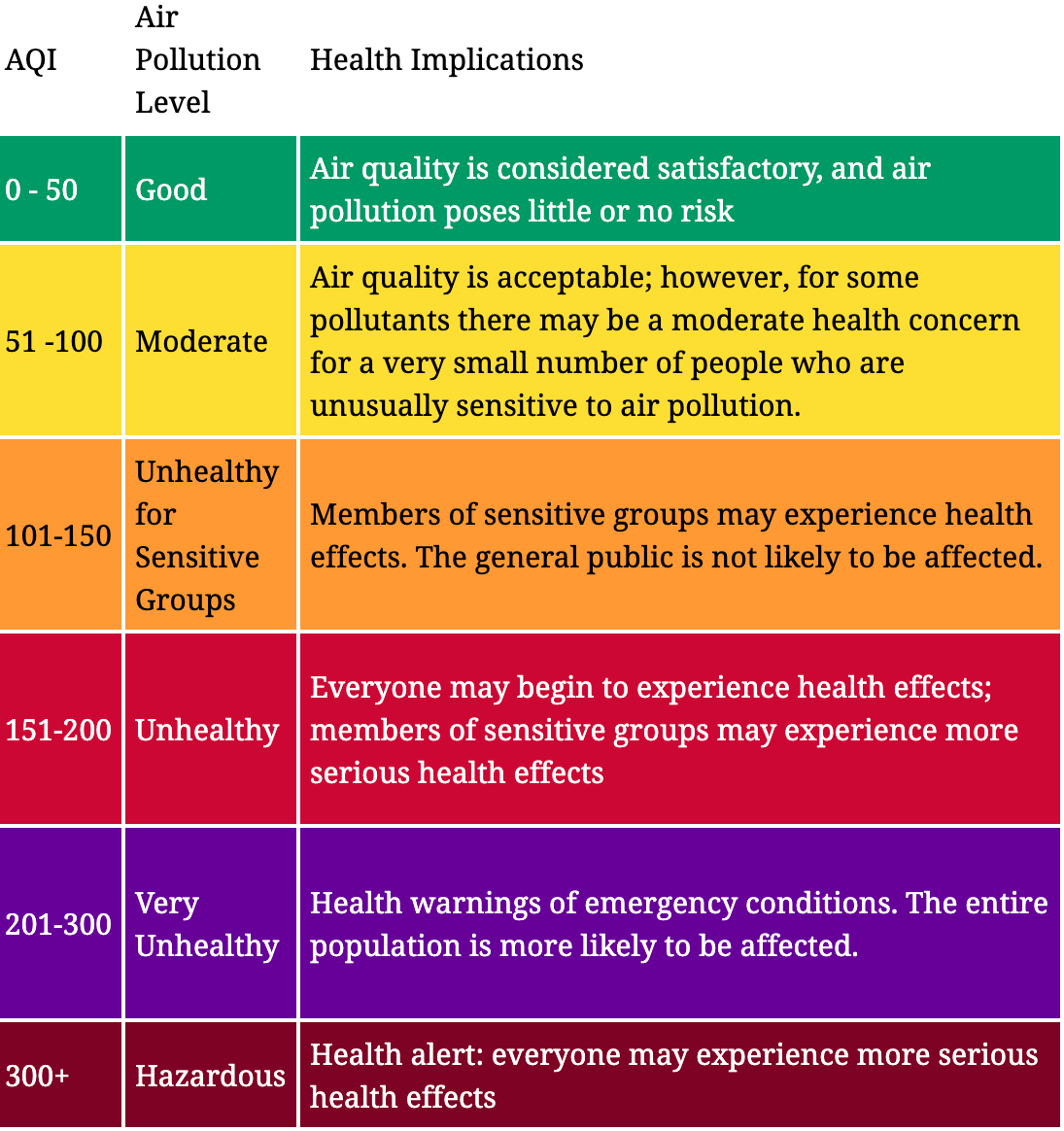
Air Quality Index : AQI
The Global Air Quality Index (AQI) is the highest AQI value calculated for each of the 6 following pollutants :
O3
PM2.5
PM10
CO
NO2
SO2
Air Quality Levels :
Notes:
So how the air quality is measured? Basically, We have an index called Global Air quality index - Global AQI which is computed from the AQI values of 6 following pollutants:
O3
Particles with an aerodynamic diameter less than 2.5μm
Particles with an aerodynamic diameter less than
10μm
Ozone
Carbon monoxide
Nitrogen Dioxed
Sulphur Dioxed

Slide 5

Dataset
Our dataset has been downloaded from the https://aqicn.org/ for the period from 1.1.2019 to 17.9.2020.
The website is developed by The World Air Quality Index team project, a non-profit project started in 2007.
The air quality information is provided for more than 130 countries, covering more than 30,000 stations in 2000 major cities.
All the Air Quality data seen on World Air Quality Index are the official data from the Environmental Protection Agency (EPA) each country .

Slide 6
Methodology & Objectives
Methodology:
From the dataset, we clean the data and then choose a sample of 16 cities to analyse.
Objectives:
By analyzing the data of this sample, our objective is to answer the following questions:
What is the change in the (median) AQI from 2019 to 2020? (of all cities / per city)?
What are the correlations between the indices of weather and the (median) AQI?(of all cities / per city)
Did the (covid19) lockdown have an impact on the air quality of all and each city?

Slide 7
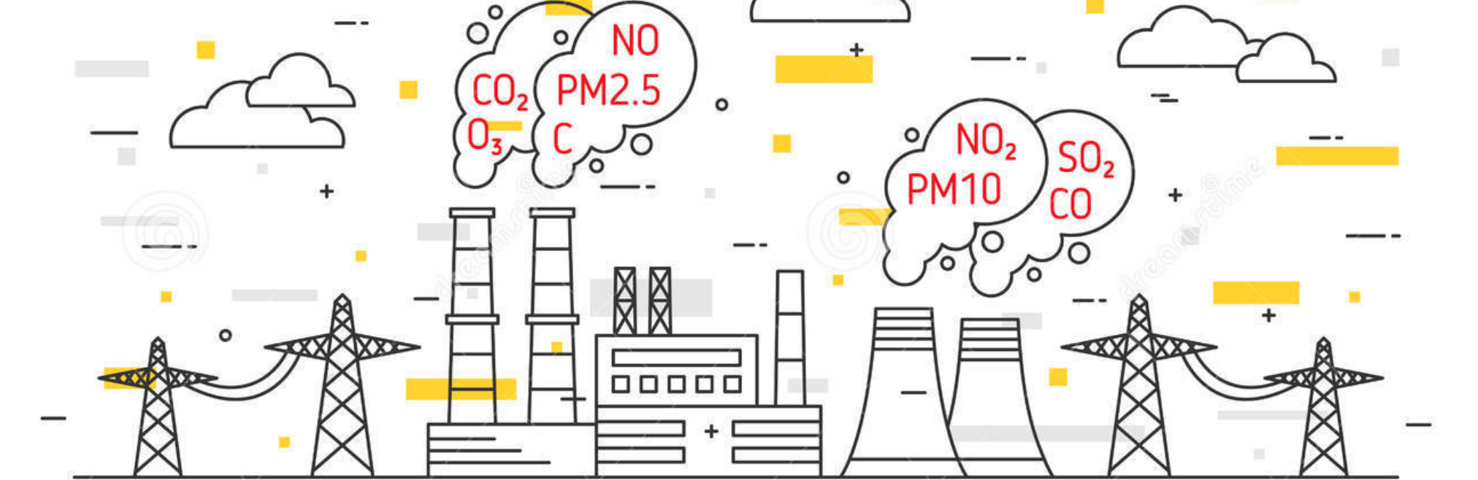
DESCRIPTION OF THE DATASET

Slide 8
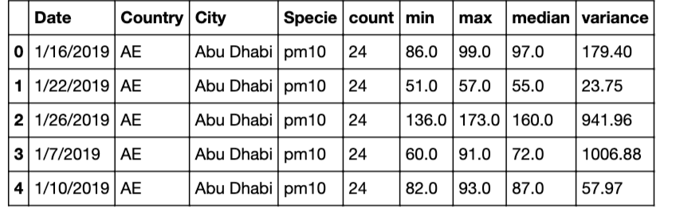
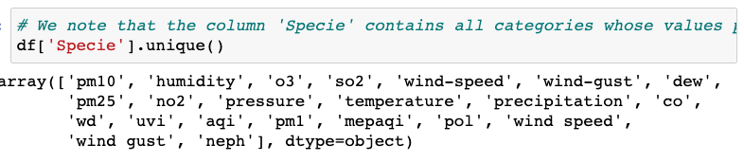
Dataset
5 csv files downloaded from the website aqicn and stored in a google drive
Read the csv files and concatenate in 1 dataframe
Number of rows : 3 223 468
Number of columns : 9
Column “Specie” has 22 indices that are related to pollution and weather
Date column : object type
The column “Country” contains the country code consisting of 2 letters

Slide 9

Dataframe : Manipulation-Cleaning

Slide 10
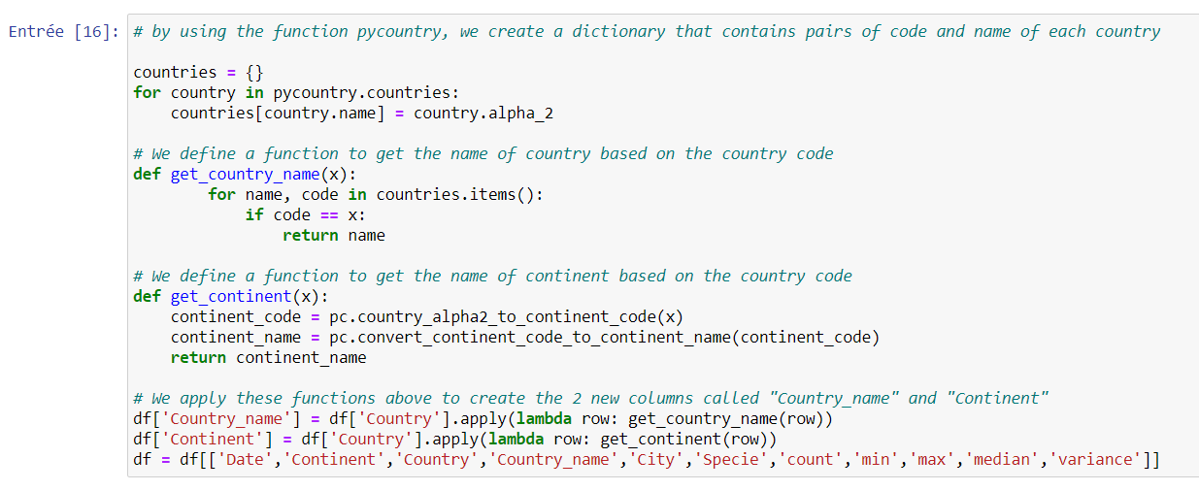
Dataframe – Manipulation & Cleaning
Add 2 columns : Continent and Country name
Drop duplicates – from (3223468 , 11) to (3158938, 11)

Slide 11
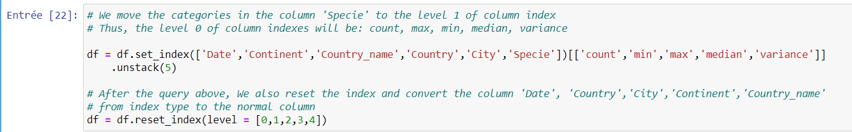
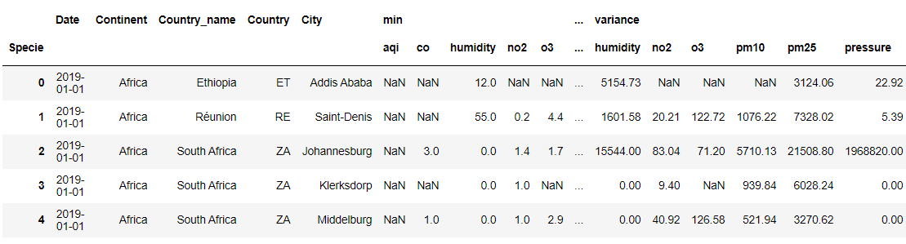
Dataframe – Manipulation & Cleaning
3. Stack the column “Specie”

Slide 12
Dataframe – Manipulation & Cleaning
4. Convert the value type of the column ‘Date’ from object-type into datetime-type
5. Drop some columns that are not useful for our analysis
6. Missing values
– columns “AQI global”: 97% of values is missing
Solution: select Max AQI values of the 6 pollutants and fill it in AQI global.

Slide 13
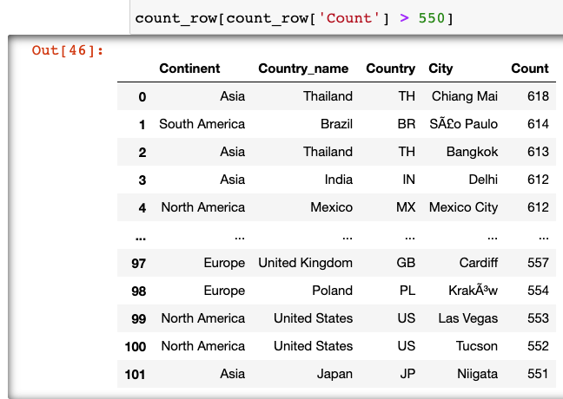
Dataframe – Manipulation & Cleaning
Missing days
the data reported is not completed for a big part of locations (number of days reported < 625 days).
These are the reasons why we will reduce the location sample for our analysis.
Remove cities that have less than 550 rows because 550 rows correspond to the number of days from 1.1.2019 to 3.7.2020.
For our project we need datas for the period of lockdown.
By examining the list above, we note that there are 101 cities whose date was reported for at least 550 days.
Given that this number of locations is still big, we decide to only take 16 cities from 13 countries of 4 continents

Slide 14

Dataframe : Sample

Slide 15
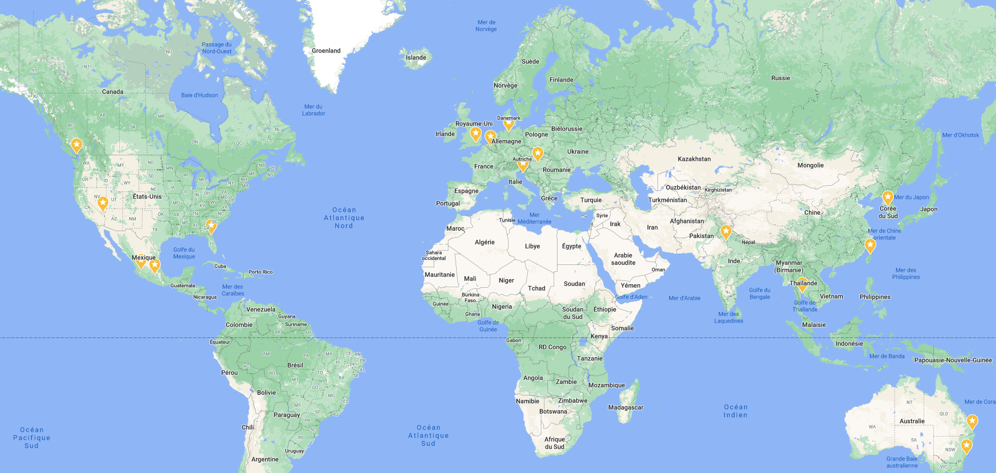
Dataframe – Sample
Our sample is now defined.
Informations concerning the sample :
16 cities :
Bangkok 613
Mexico City 612
Delhi 612
Taipei 609
Budapest 607
London 605
Seoul 603
Hamburg 599
Rows : 9492 and columns : 49
Guadalajara 595
Vancouver 594
Jacksonville 594
Sydney 590
Rijeka 578
Brisbane 578
Las Vegas 553
Brussels 550

Slide 16
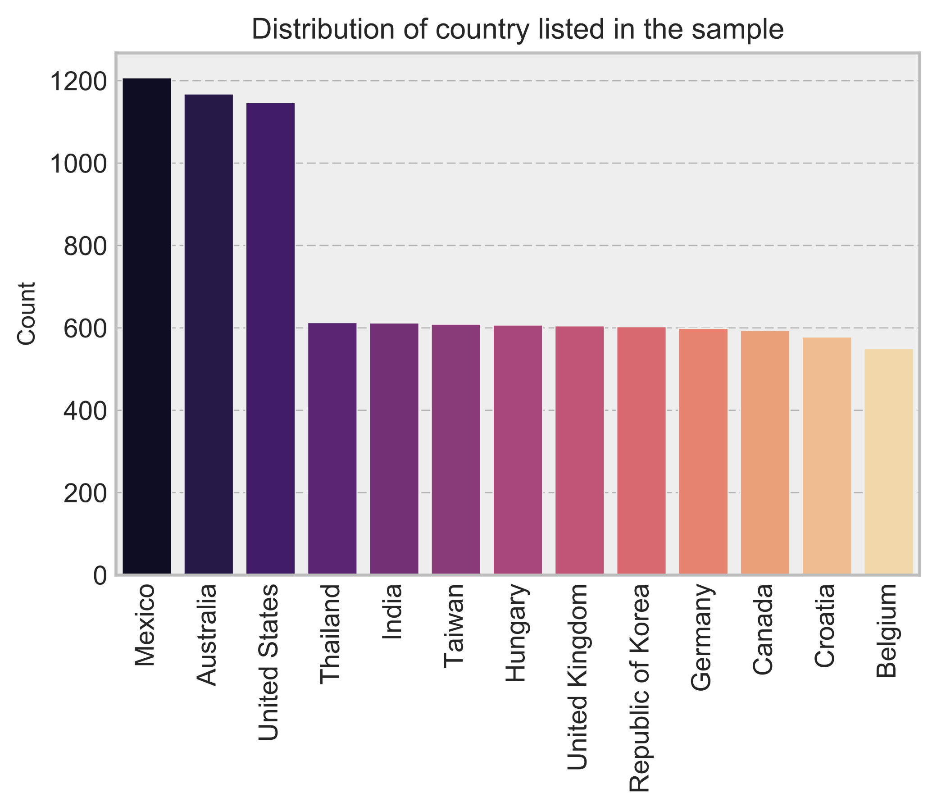
Dataframe – Sample
As we can see, Mexico, Australia and the US contribute the most to our dataset sample because they have more selected cities in the sample compared to others.

Slide 17
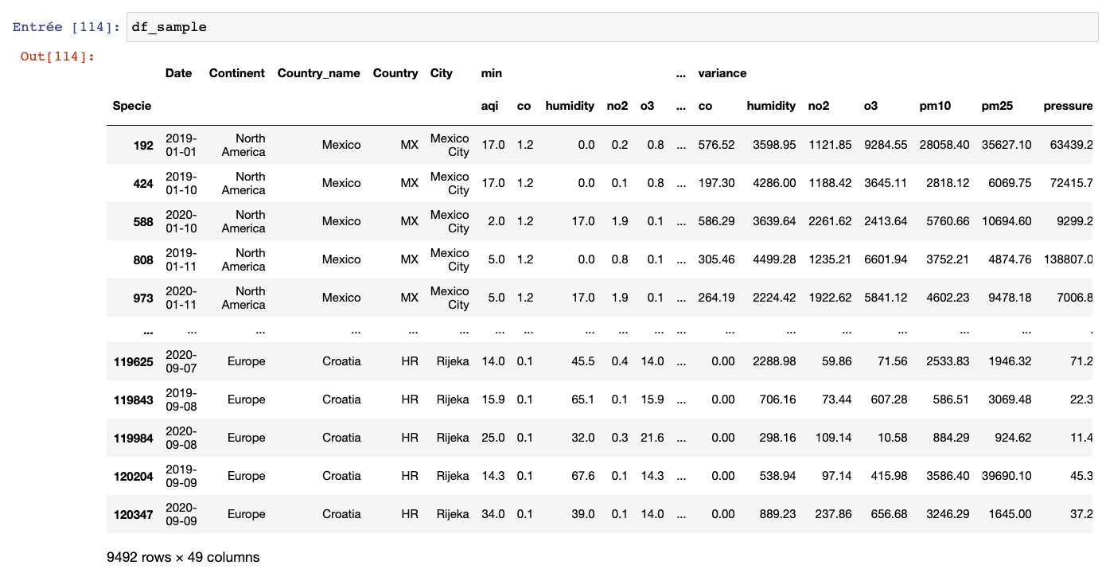
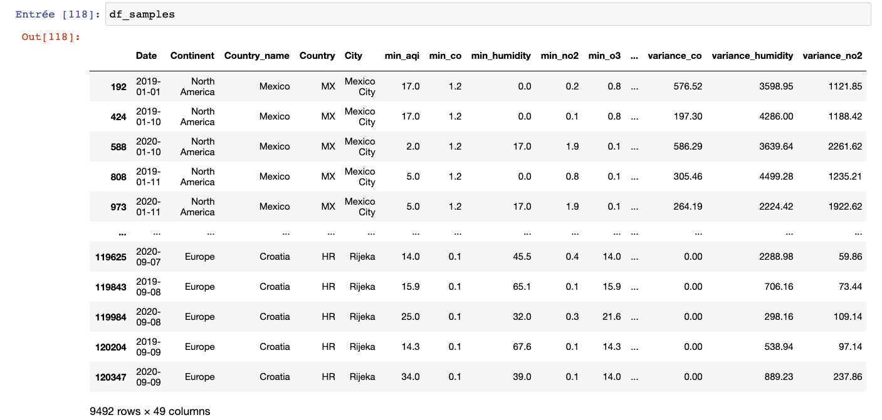
Dataframe - Sample
We have decided to analyse the median AQI :
the median is telling how the principal value of the index was during all the day
1 level of column

Slide 18
Evolution 2019/2020 Visualization from Dataframe Sample

Slide 19
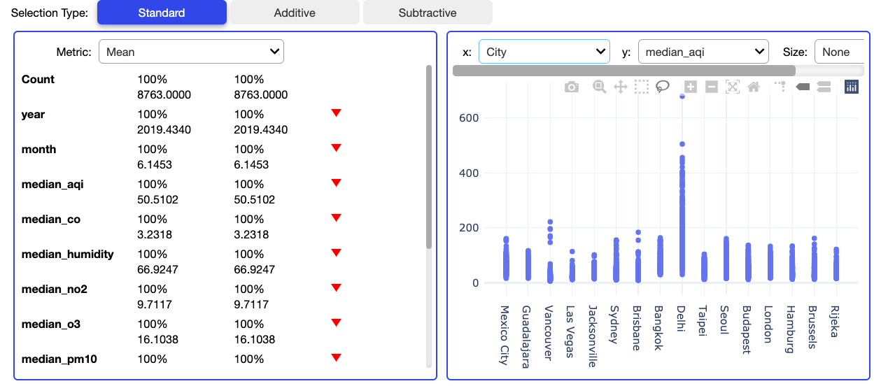
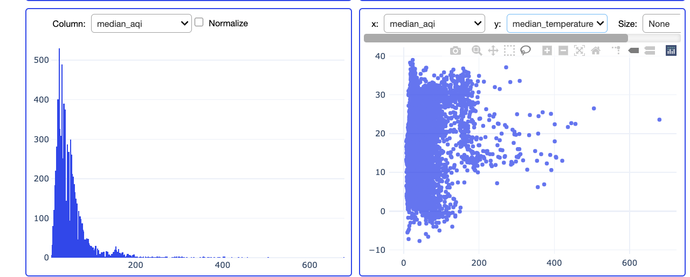
VizualAnalysis of the sample
Widgets - with scrolling menu
graphs can be downloaded for 3 of these widgets
On the 1st row,
On the left, the mean of the year, month and indicators are not interesting here
On the right, thanks to the scrolling menus, we can make a bar graph ‘like’, easily.
On the 2nd row,
On the left, we see a curve line specific of the normal
distribution, for the median aqi and it is a right skewed.
On the right, hanks to the scrolling menus, we can make a scatter plot ‘like’, easily.

Slide 20
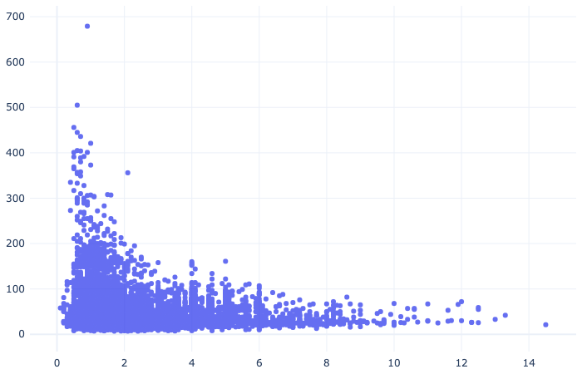
VizualAnalysis of the sample
Example of graph downloaded; distribution median aqi/Wind speed

Slide 21
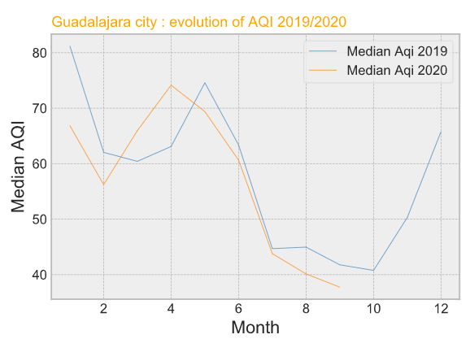
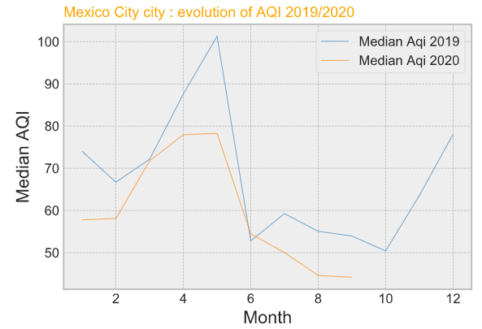
Graphs lines
Continent: America
Country: Mexico
We notice that the evolution of the median aqi seems to follow more or less the same evolution from 2019 to this year.
For Mexico city, the median AQI 2020 is clearly under the median AQI of 2019. This year, the city has been less pollute than the year before.

Slide 22
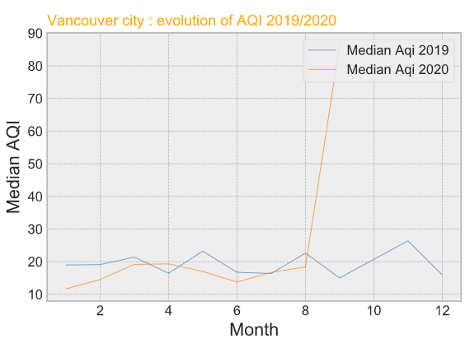
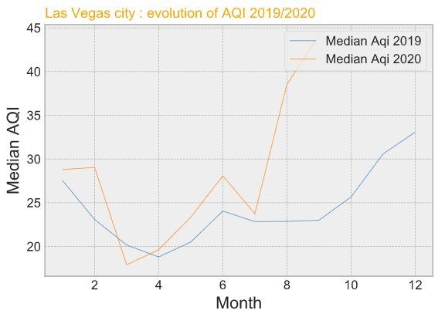
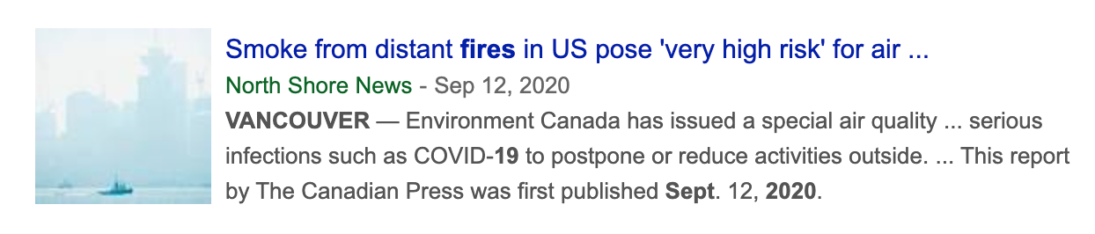
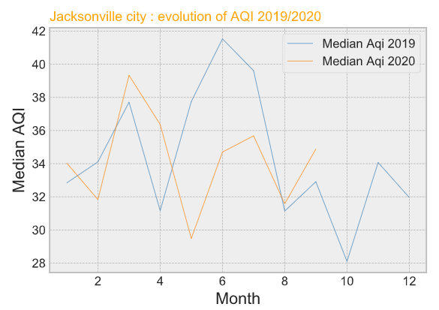
Graphs lines
Continent: America
Country: Canada
Continent: America
Country: USA
This article talk about fires
from usa that has had very high risks for air quality in Vancouver.
We relate the hill of the median AQI with this information.
Here also, we notice that the evolution of the median aqi seems to follow more or less the same evolution from 2019 to this year.

Slide 23
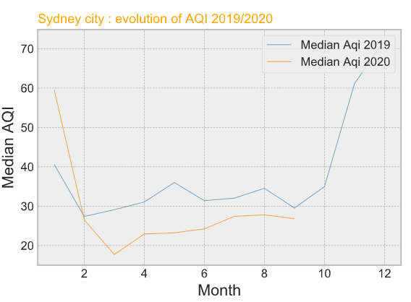
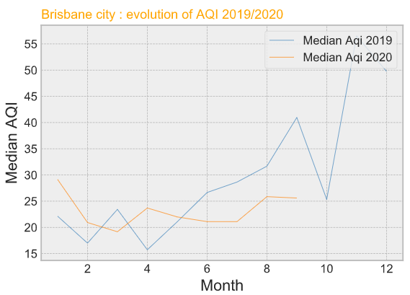
Graphs lines
Continent: Oceania
Country: Australia
Bushfires in Australia from november 2019 to january 2020 has to be related to the hill in the graph. These fires now start at the same periods of the year. Other examples in the world of periodics bushfires : California, Chile.
https://www.bbc.com/news/world-australia-50951043

Slide 24
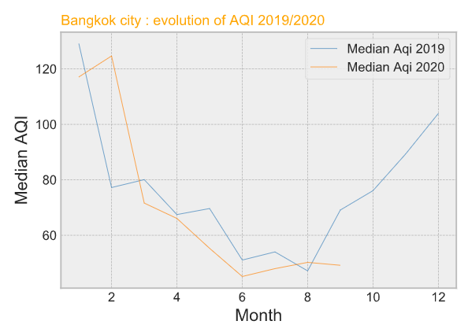
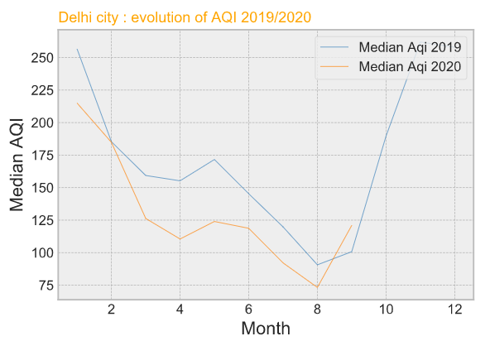
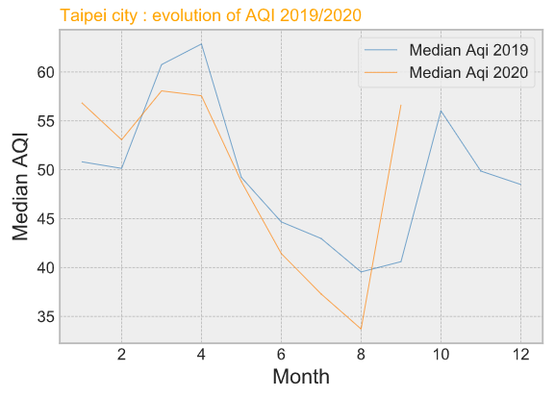
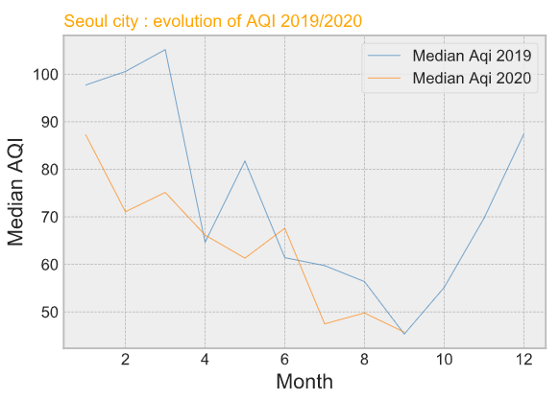
Graphs lines
Continent: Asia
In Asia, we observe that the period from may to septembre is where the pollution is the lower.
But Dheli is always very pollute all the year.
Bangkok, Seoul may have a median of AQI very high that’s mean is very pollute some months of the year.
.

Slide 25
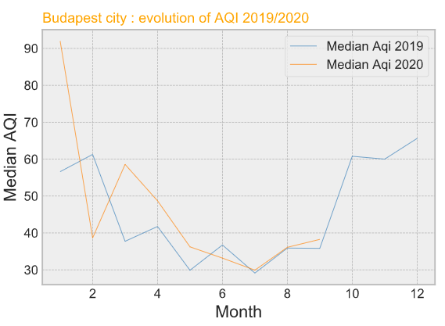
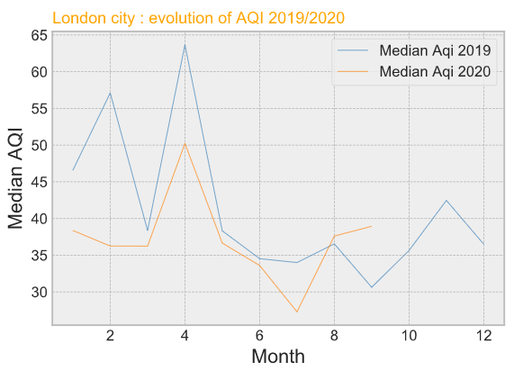
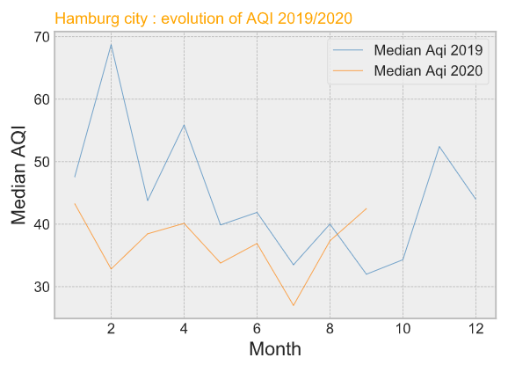
Graphs lines
Continent: Europe
In Europe, these cities are always under a median IQA of 70 so beetween a good and Modarate level of pollution.
.

Slide 26
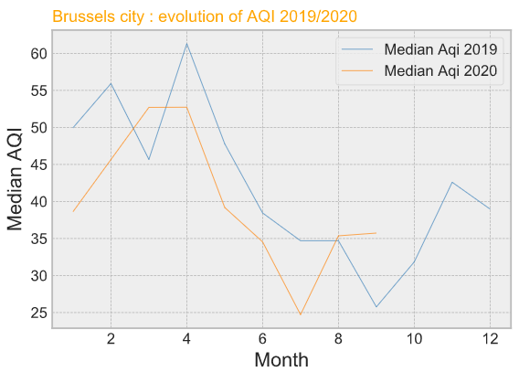
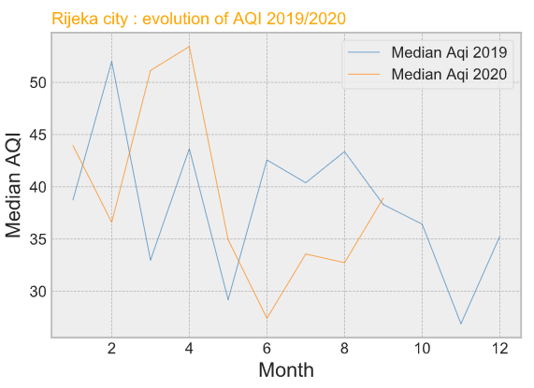
Graph lines
Continent: Europe

Slide 27
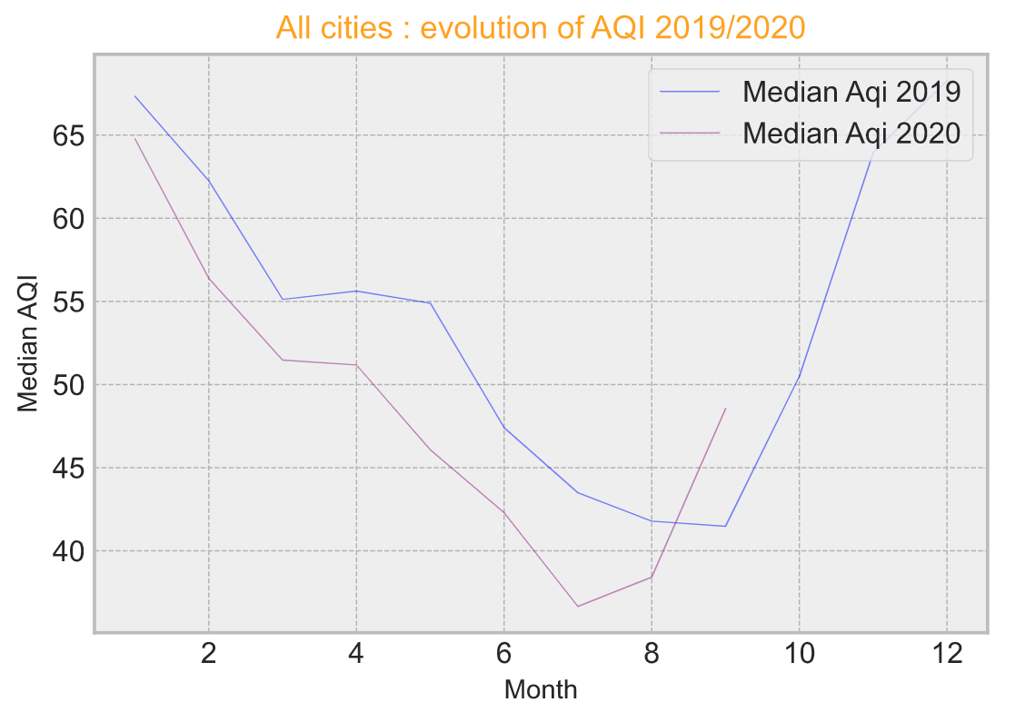
Question
What is the change in the (median) AQI from 2019 to 2020: for a sample of cities? per city of this sample?
We notice that the evolution of the median aqi seems to follow more or less the same evolution from 2019 to this year.
Overall, for the period from January to February, the level of pollution seems to have been lower than last year for all the cities of our sample.

Slide 28
Density plot- Dataframe Sample

Slide 29
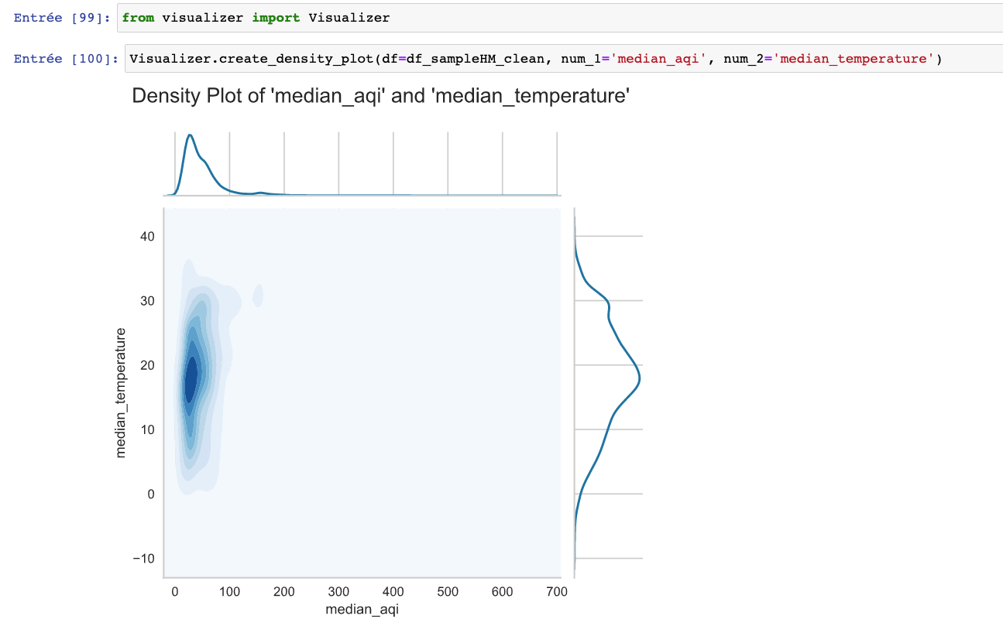
Density plot median AQI/Indicators of weather
Rows with Null values has been dropped for the density plot
The dark blue spot indicates the high repartition of median AQI/median temperature for all the cities of our sample.
Median AQI approx = 45
Temperature approx = 15°C/22°C
Lets study per city, the results may be very different.

Slide 30
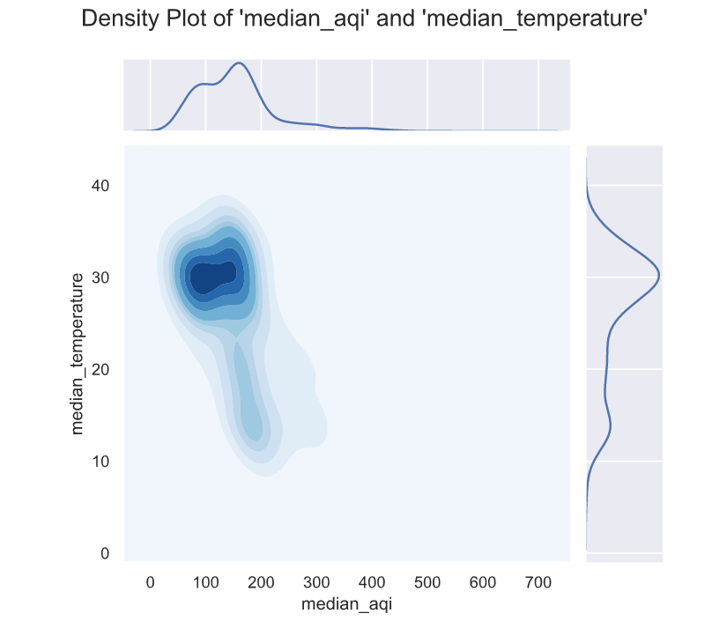
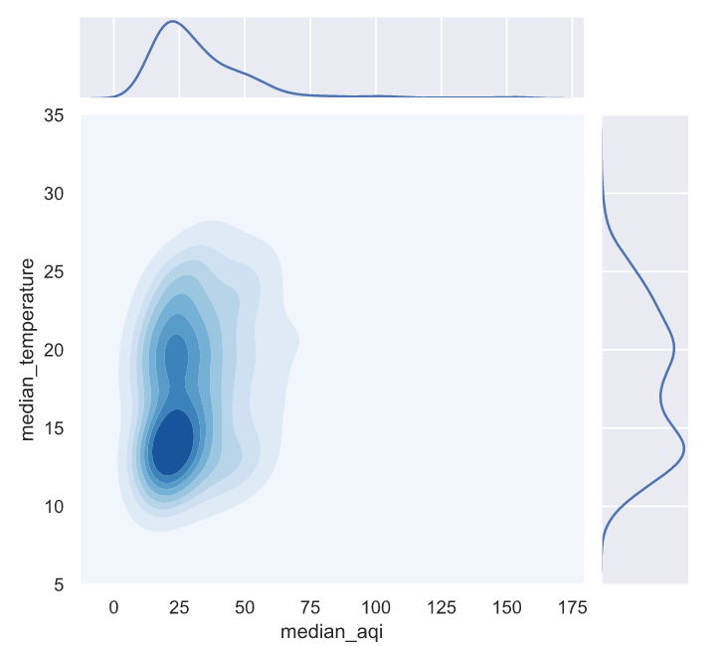
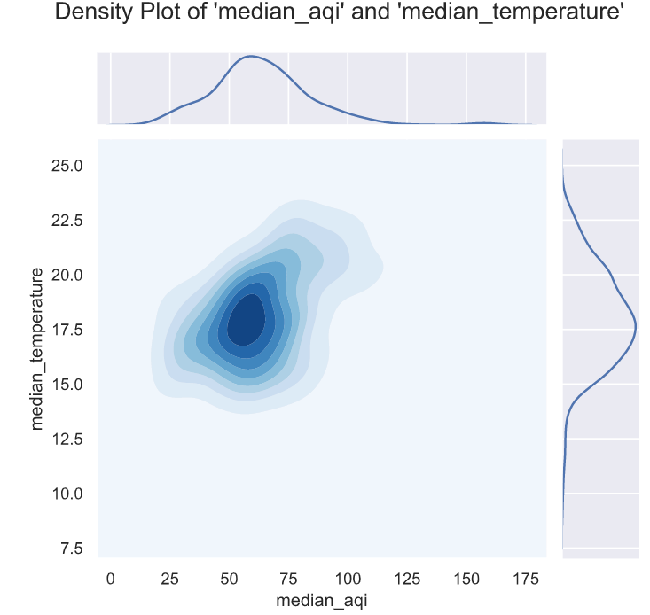
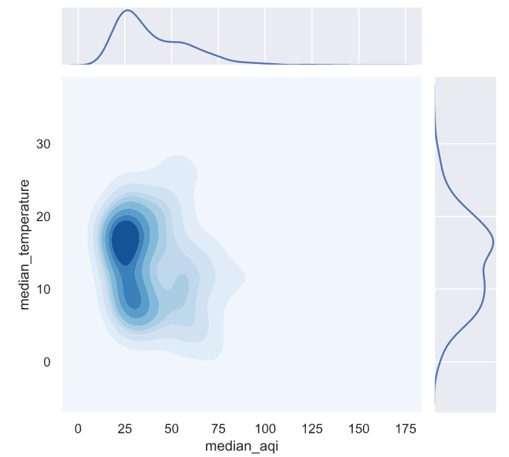
Density plot median AQI/Indicators of weather per city
Delhi – from 2019 today
Median AQI approx = 100-200
Median temp approx = 30°C
Sydney – from 2019 today
Median AQI approx = 20-40
Median temp approx = 12°C-17°C
Mexico City – from 2019 today
Median AQI approx = 50-70
Median temp approx = 17°C-20°C
Brussel – from 2019 today
Median AQI approx = 20-45
Median temp approx = 12°C-20°C
The density plot is more relevant for each city than for the whole sample. Looking at those 4 graphs, it
seems that temperature is correlated with AQI.
It is surprising that the density of temperature for Brussels is between 12°C-20°C!

Slide 31
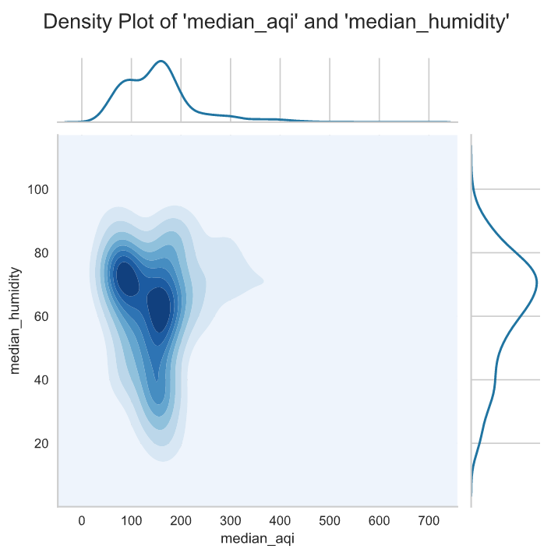
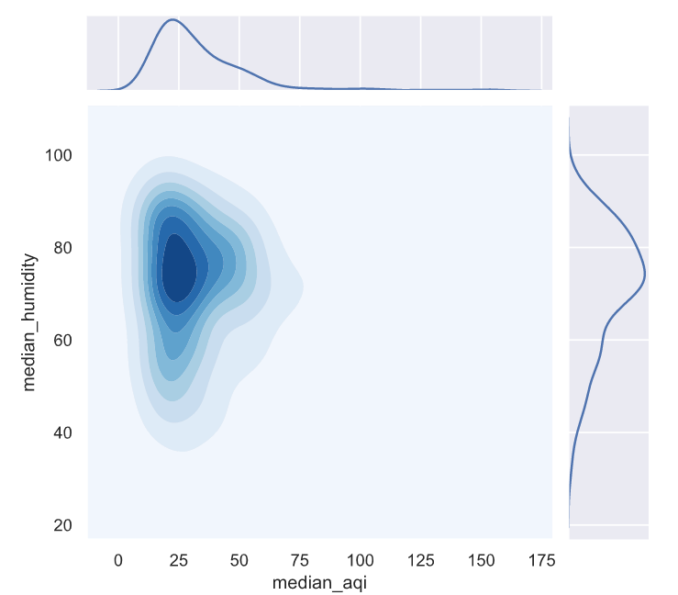
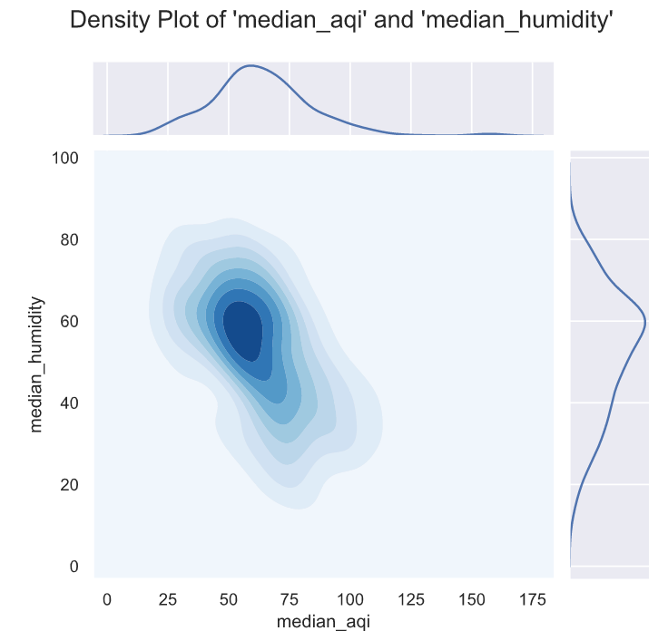
Density plot median AQI/Humidity per city
Delhi – from 2019 today
Median AQI approx = 100-200
Median Humidity approx = 55-80
Sydney – from 2019 today
Median AQI approx = 20-40
Median Humidity approx = 70-85
Mexico City – from 2019 today
Median AQI approx = 50-70
Median Humidity approx = 50-65

Slide 32
Correlation- Dataframe Sample

Slide 33
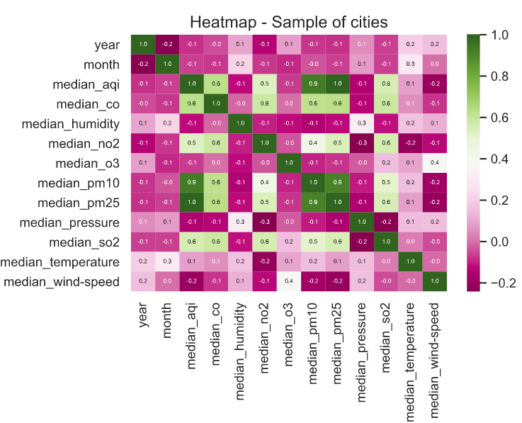
Correlation – Sample
Correlation between Median AQI and the other indicators pollution and weather.
indicators pollution and weather
Correlation for the whole sample of cities
Correlation for each cities.
In this heat map, we can read that the median aqi has a strong correlation with the median pm10 and the median pm25. In fact, the median aqi is the maximum of all these indicators, median: pm, co, so2,03, no2 so this first result is normal.
What is surprising is that median of co, so2,03, no2 do not appear with a stronger correlation with the median aqi. It is possible that this is due to the zero values for these indicators or may be due to an bad collecting from the sensor. We must therefore undoubtedly have some outliers.
Here with our sample, we cannot determine a strong correlation between median aqi and median (wind, temperature, pressure, humidity) this could be due to the outliers.

Slide 34
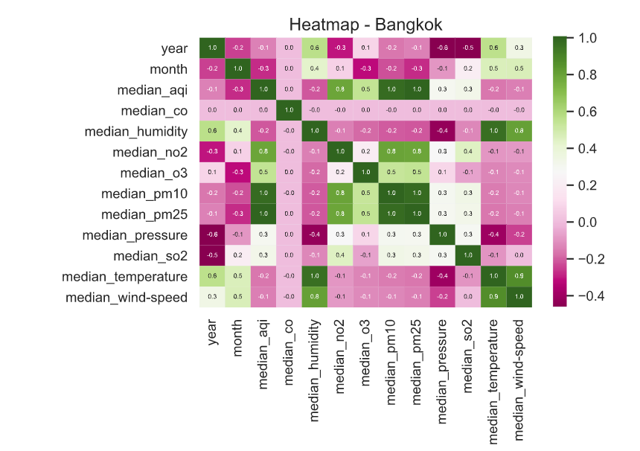
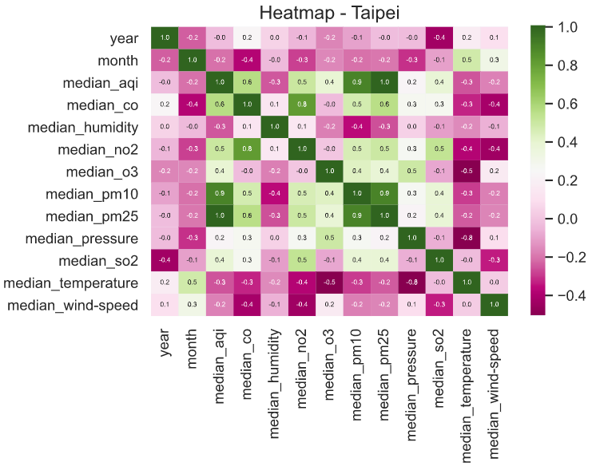
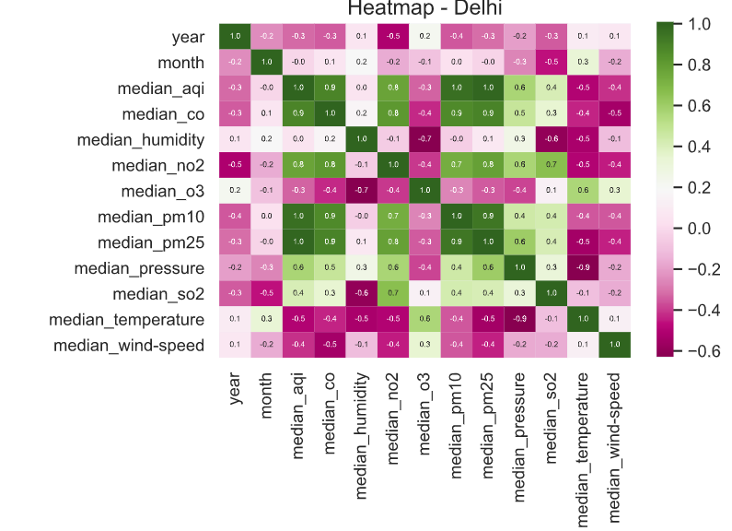
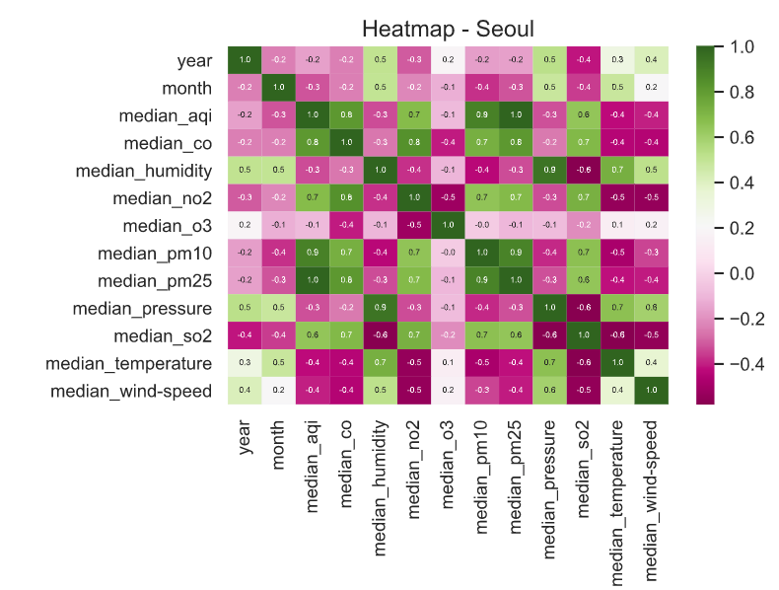
Correlation – Sample for cities (ASIA)
Correlation between median AQI and Indicators are never strong. 1 function in python.
Bangkok : correlation Median AQI/Pressure= -0,3
Dehli : correlation Median AQI/Pressure = 0,5

Slide 35
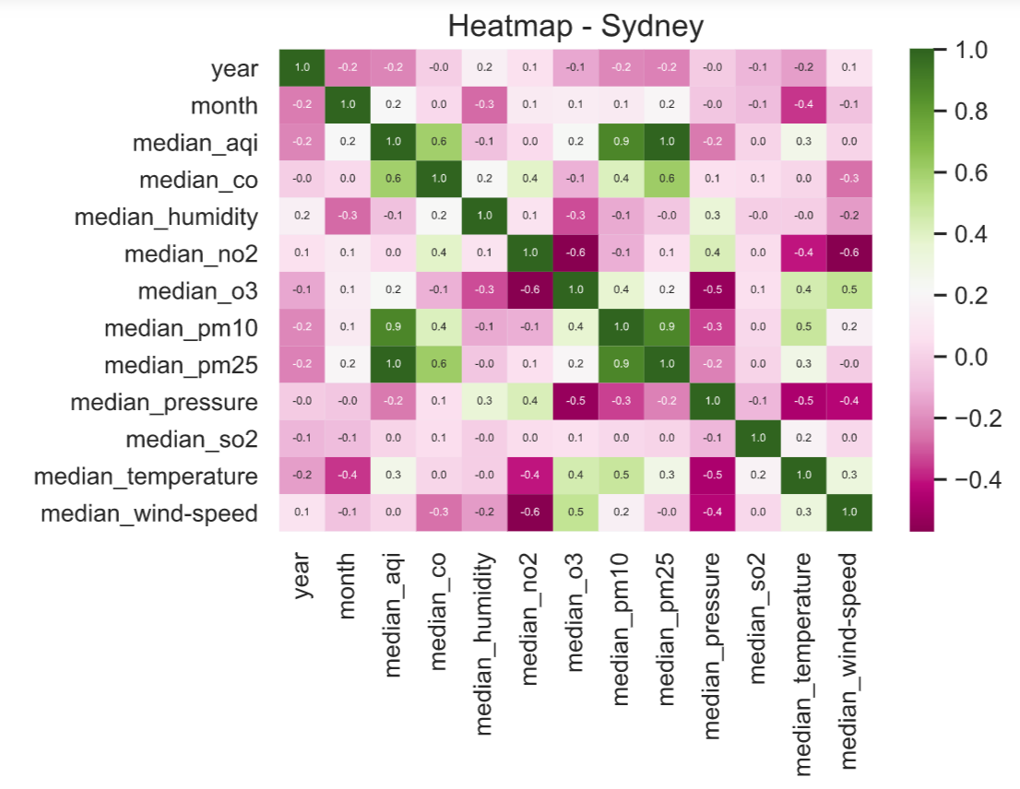
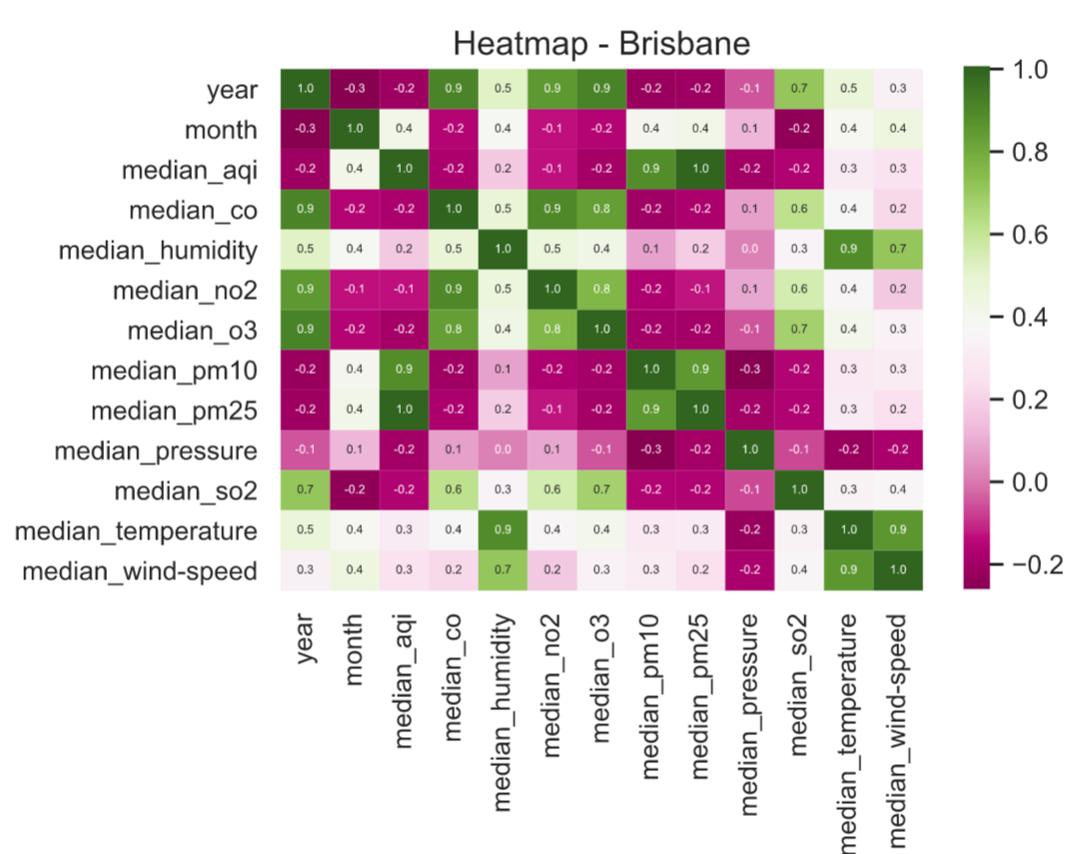
Correlation – Sample for cities (oceanie)
Sydney: correlation Median AQI/Temperature = 0,3
Brisbane: correlation Median AQI/Temperature and AQI/Wind = 0,3
Bangkok : correlation Median AQI/Pressure= -0,3

Slide 36





Correlation – Sample for cities (America)
Mexico : correlation Median AQI/Humidity = -0,4
Jacksonville
Guadalajara
Las Vegas
Vancouver

Slide 37
Correlation – Sample for cities (America)
Mexico : correlation Median AQI/Humidity = -0,4
Jacksonville
Guadalajara
Las Vegas
Vancouver

Slide 38




Correlation – Sample for cities (europe)

Slide 39
Question
What are the correlations between the indices of weather and the (median) AQI in 2019 and 2020: for a sample of cities ? per city of this sample?
Studying the heatmap of the sample and each city, we can observe the direction of the relationship between these elements.
However, since the strength of the displayed correlations is too weak, we cannot conclude with our data that there are correlations between the aqi (the pollution) and the indicator of weather.
We think that one of the principal reasons for it could be:
our dataset is a report with the median value per day, while the change of AQI index and the indicators of weather is frequently during the day. Thus, it would be more relevant if we could use the hourly data to verify the correlation.

Slide 40
Hypothesis test- Dataframe Sample

Slide 41

Z-TEST

Slide 42
Difficulties/Improvements
Difficulties:
Domain knowledge
Data cleaning
Manipulate a big jupyter file. Take time to reply with the vizualization.
Improvements:
Create the Choropleth map with Python
Uplaod data for Paris
Understand how to interpret yellowbrick
[Advices from Eldiaas :
scale of the graphs must be same when you are comparing.
focus on what is important. don’t take too much time to show all the viz.]

Slide 43
Links
The project is on github :
https://github.com/tatiana-martinez/AirQuality.git
Trello created for the project:
https://trello.com/b/NsH3Z4Rc/projet-2-eda-air-quality

Slide 44
Thank you for your attention :)

Slide 45

Appendix
pollutant concentration data :
Ozone (ppm) – truncate to 3 decimal places
PM2.5 (μg/m3) – truncate to 1 decimal place
PM10 (μg/m3) – truncate to integer
CO (ppm) – truncate to 1 decimal place
SO2 (ppb) – truncate to integer
NO2 (ppb) – truncate to integer
How the AQI from pollutant concentration data are calculated:

Slide 46

Appendix

